Slide 1
GCBASIC
PIC16Fxxxx chip Family ( Legacy )
Part 15 – External interrupt

Slide 2
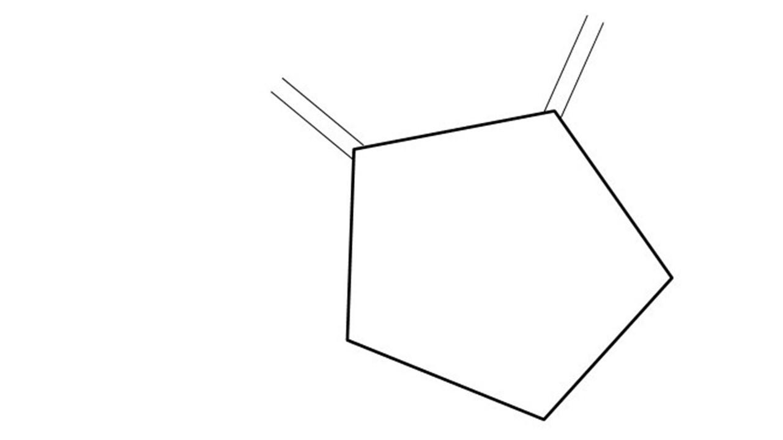
GCBASIC
PIC16Fxxxx chip Family ( Legacy )
Part 15 – External interrupt
January 2025

Slide 3
GCBASIC
Like and subscribe!

Slide 4
PIC16Fxxxx
PIC16Fxxxx is a high performance PIC16
Digital and Analog peripherals
8 –bit or 10-bit ADC
Multiple communication interfaces
Serial, I2C and SPI
PWM – CCP/PWM and 16Bit
The PIC16 offers 8, 14,18,20, 28, 40 and 48-pin packages to support customers in a wide variety of applications.

Slide 5
Videos...
Install the hardware and make the board work – make LEDs work
Make four LEDs flash in a sequence
Set the LEDs to represent the value of ADC
Sequence the LEDs with a delay using the value of ADC
Using an input to set the state of the LEDs
Using the reset switch
Using the switch, ADC – make the LEDs flash in a sequence with reverse
Using the serial to display values
Using the timer0 overflow, 8bit timer, 16bit timer to flash the LEDs
Using EEProm – showing values on the serial terminal, and more constants insights
Using I2C with serial to discover I2C devices
Using an I2C GCLD display
Using a SPI GCLD display
Using PWM, many ways, to dim the LEDS
Using an external interrupt to control an LED
Using storage within the chip – Progmem, EEPROM and DATA blocks
The GCBASIC tool chain
Assembly , alternatives assemblers and MPLAB-X
Summary

Slide 6
GCBASIC Compiler
GCBASIC Compiler
GCBASIC is an Open Source compiler for PIC, AVR and LGT microcontrollers
GCBASIC supports the 16Fxxxx chip family

Slide 7
Prerequisites
Assumes you have
Installed the GCBASIC software
Installed your programmer software
Test that you have the PIC attached
You have the 4 LEDs operating
You have a POT connected
You have switches connected
You have USB/TTL serial converter
You have LCD

Slide 8
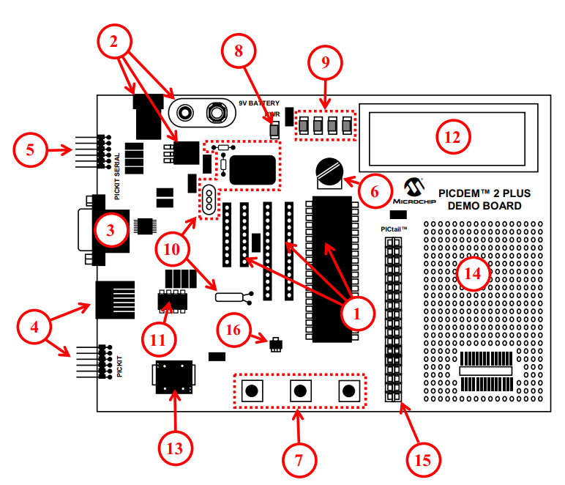
Hardware
The PICDEM 2 Plus Demonstration Board
18-, 28- and 40-pin DIP sockets (although three sockets are provided, only one device may be used at a time)
On-board, +5V regulator for direct input from 9V, 100 mA AC/DC wall adapter or 9V battery, or hooks for a +5V, 100 mA regulated DC supply
RS-232 socket and associated hardware for direct connection to an RS-232 interface
Programmer/debugger connectivity supporting MPLAB® ICD 3, MPLAB REAL ICE, PICkit 2 and PICkit 3
PICkit Serial Connector for analysis of serial communications peripherals such as SPI or I2C™
5 k pot for devices with analog inputs
Three push button switches for external stimulus and Reset
Power-on indicator LED
Four LEDs connected to PORTB
On-board external oscillators including: a) Unpopulated DIP socket for canned crystal oscillator (Y2) b) RC oscillator circuit (R4, C3) c) Unpopulated holes for crystal connection (Y1) d) 32.768 kHz crystal for Timer1 clock operation (Y3)
32K x 8 Serial EEPROM
LCD display
Piezo buzzer
Prototype area for user hardware
Expansion Header for PICtail™ daughter card connectivity or user access to
MCUs
Microchip TC74 thermal sensor

Slide 10
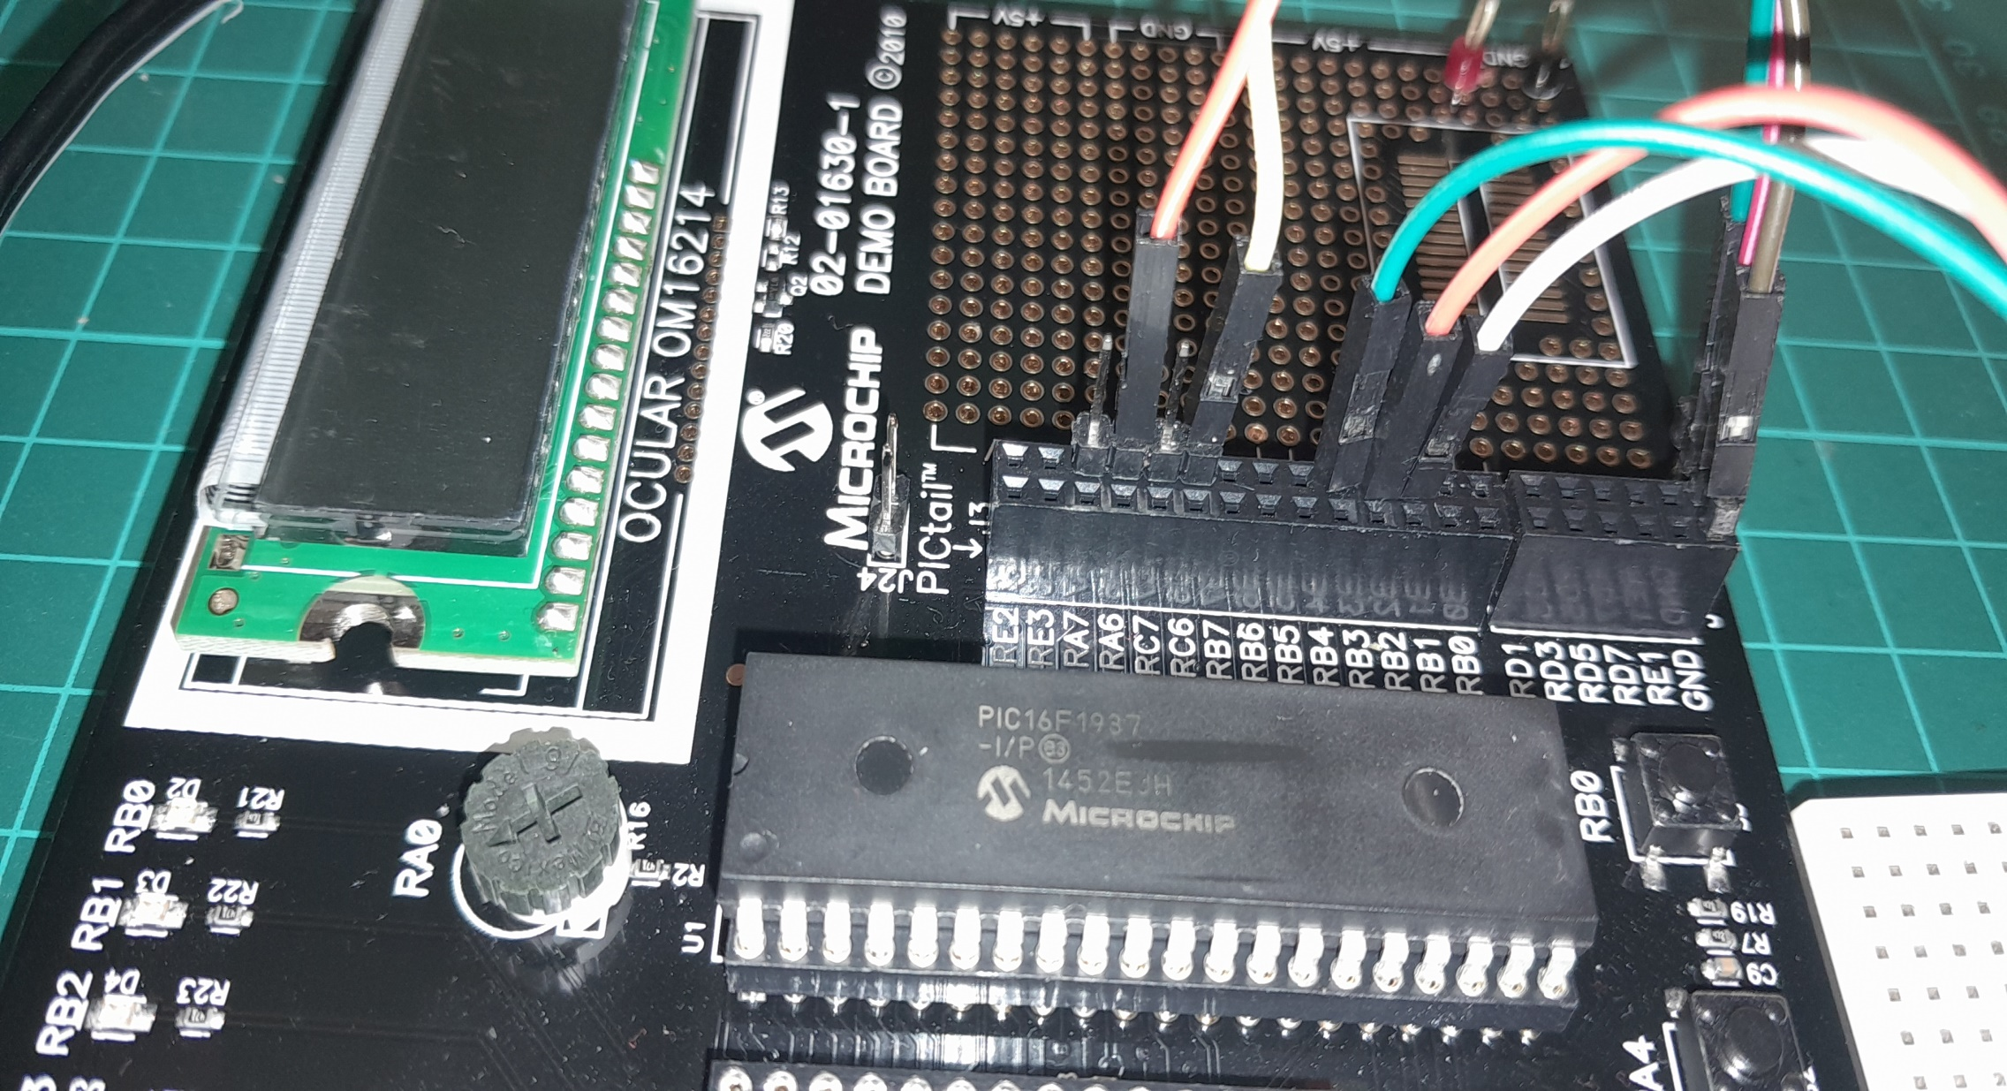

Slide 11
Hardware
Hardware
------------PORTA---------------
Bit#: -7---6---5---4---3---2---1---0---
IO: ------------SW2-------------ADC--
IO: ---------------------------------
------------PORTB----------------
Bit#: -7---6---5---4---3---2---1---0---
IO: ----------------LED-LED-LED-INT--
IO: ---------------------------------
------------PORTC----------------
Bit#: -7---6---5---4---3---2---1---0---
IO: -----TX--------------------------
IO: ---------------------------------
------------PORTD----------------
Bit#: -7---6---5---4---3---2---1---0---
IO: ---------------------------------
IO: ---------------------------------
------------PORTE----------------
Bit#: -7---6---5---4---3---2---1---0---
IO: ----------------RST---------------
IO: ---------------------------------
Prototype Board
Power 5v0
Programmer
LEDs & resistors
Switches
TTL/USB

Slide 12
Principles of Interrupts
Interrupts are events that alter the normal execution flow of a program to respond to external or internal events.
Advantages
Immediate response to critical events
Efficient use of the microcontroller's resources
Types of Interrupts
External Interrupts: Triggered by events on external pins (RB0/INT0, RB1/INT1, etc.)
Timer Interrupts: Triggered by timer overflows or matches
Peripheral Interrupts: Triggered by events from peripherals (USART, ADC, etc.)
Software Interrupts: Triggered by software instructions
Key Registers
INTCON: Controls global interrupt enable and individual interrupt flags
PIE1, PIE2: Peripheral Interrupt Enable registers
PIR1, PIR2: Peripheral Interrupt Request (flag) registers
Interrupt Service Routine (ISR)
Special function that executes when an interrupt occurs
Must be as short and efficient as possible to avoid delaying other operations

Slide 13
Interrupts…
For specific details of the interrupts see the microcontroller datasheet
The first parameter is the GCBASIC identifier used in user code to expose the specific interrupt
ADCReady:ADIE,ADIF
CCP1:CCP1IE,CCP1IF
CCP2:CCP2IE,CCP2IF
CCP3:CCP3IE,CCP3IF
CCP4:CCP4IE,CCP4IF
CCP5:CCP5IE,CCP5IF
Comp1Change:C1IE,C1IF
Comp2Change:C2IE,C2IF
EEPROMReady:EEIE,EEIF
ExtInt0:INTE,INTF
LCDReady:LCDIE,LCDIF
OscillatorFail:OSFIE,OSFIF
PORTBChange:IOCIE,IOCIF
PortChange:IOCIE,IOCIF
SSP1Collision:BCLIE,BCLIF
SSP1Ready:SSPIE,SSPIF
Timer0Overflow:TMR0IE,TMR0IF
Timer1Gate:TMR1GIE,TMR1GIF
Timer1Overflow:TMR1IE,TMR1IF
Timer2Match:TMR2IE,TMR2IF
Timer4Match:TMR4IE,TMR4IF
Timer6Match:TMR6IE,TMR6IF
UsartRX1Ready:RCIE,RCIF
UsartTX1Ready:TXIE,TXIF
PIC16F1937

Slide 14
Interrupts…
ExtInt1:INT1IE,INT1IF
ExtInt2:INT2IE,INT2IF
I2C1ErrorInterrupt:I2C1EIE,I2C1EIF
I2C1Interrupt:I2C1IE,I2C1IF
I2C1ReceiveInterrupt:I2C1RXIE,I2C1RXIF
I2C1TransmitInterrupt:I2C1TXIE,I2C1TXIF
LogicCell1Event:CLC1IE,CLC1IF
LogicCell2Event:CLC2IE,CLC2IF
LogicCell3Event:CLC3IE,CLC3IF
LogicCell4Event:CLC4IE,CLC4IF
NVMComplete:NVMIE,NVMIF
OscillatorFail:OSFIE,OSFIF
PORTABChange:IOCIE,IOCIF
PWM1MatchEvent:PWM1IE,PWM1IF
PWM2MatchEvent:PWM2IE,PWM2IF
PWM2PeriodEvent:PWM2PIE,PWM2PIF
PWMPeriodEvent:PWM1PIE,PWM1PIF
PortChange:IOCIE,IOCIF
SPIInterrupt:SPI1IE,SPI1IF
SPIReceiveInterrupt:SPI1RXIE,SPI1RXIF
SPITransmitInterrupt:SPI1TXIE,SPI1TXIF
ScanComplete:SCANIE,SCANIF
SoftwareInterrupt:SWIE,SWIF
Timer0Overflow:TMR0IE,TMR0IF
Timer1Gate:TMR1GIE,TMR1GIF
Timer1Overflow:TMR1IE,TMR1IF
Timer2Match:TMR2IE,TMR2IF
Timer4Match:TMR4IE,TMR4IF
UART1FramingErrorInterrupt:U1EIE,U1EIF
UART1Interrupt:U1IE,U1IF
UART1ReceiveInterrupt:U1RXIE,U1RXIF
UART1TransmitInterrupt:U1TXIE,U1TXIF
UART2FramingErrorInterrupt:U2EIE,U2EIF
UART2Interrupt:U2IE,U2IF
UART2ReceiveInterrupt:U2RXIE,U2RXIF
UART2TransmitInterrupt:U2TXIE,U2TXIF
VoltageFail:HLVDIE,HLVDIF
For specific details of the interrupts see the microcontroller datasheet
The first parameter is the GCBASIC identifier used in user code to expose the specific interrupt
16bitUniversalTimerAInterrupt:TU16AIE,TU16AIF
16bitUniversalTimerBInterrupt:TU16BIE,TU16BIF
ADCReady:ADIE,ADIF
ADThreshold:ADTIE,ADTIF
ActiveClockTuning:ACTIE,ACTIF
CCP1:CCP1IE,CCP1IF
CCP2:CCP2IE,CCP2IF
CRCComplete:CRCIE,CRCIF
CWG1ShutDown:CWG1IE,CWG1IF
ClockSwitchComplete:CSWIE,CSWIF
DMA1AbortInterrupt:DMA1AIE,DMA1AIF
DMA1DestinationCountInterrupt:DMA1DCNTIE,DMA1DCNTIF
DMA1OverrunInterrupt:DMA1ORIE,DMA1ORIF
DMA1SourceCountInterrupt:DMA1SCNTIE,DMA1SCNTIF
DMA2AbortInterrupt:DMA2AIE,DMA2AIF
DMA2DestinationCountInterrupt:DMA2DCNTIE,DMA2DCNTIF
DMA2OverrunInterrupt:DMA2ORIE,DMA2ORIF
DMA2SourceCountInterrupt:DMA2SCNTIE,DMA2SCNTIF
DMA3AbortInterrupt:DMA3AIE,DMA3AIF
DMA3DestinationCountInterrupt:DMA3DCNTIE,DMA3DCNTIF
DMA3OverrunInterrupt:DMA3ORIE,DMA3ORIF
DMA3SourceCountInterrupt:DMA3SCNTIE,DMA3SCNTIF
DMA4AbortInterrupt:DMA4AIE,DMA4AIF
DMA4DestinationCountInterrupt:DMA4DCNTIE,DMA4DCNTIF
DMA4OverrunInterrupt:DMA4ORIE,DMA4ORIF
DMA4SourceCountInterrupt:DMA4SCNTIE,DMA4SCNTIF
ExtInt0:INT0IE,INT0IF
ExtInt1:INT1IE,INT1IF
PIC18FxxQ24

Slide 15
Interrupt on Change (IOC)
Detects changes in the state of selected pins
Key Points
Configuration: Set IO port.pin as inputs and configure the correct register for edge detection (rising or falling edge).
Interrupt Service Routine (ISR)
Handles the interrupt event
Global Interrupt Enable (GIE):
Enables the microcontroller to respond to interrupts

Slide 16
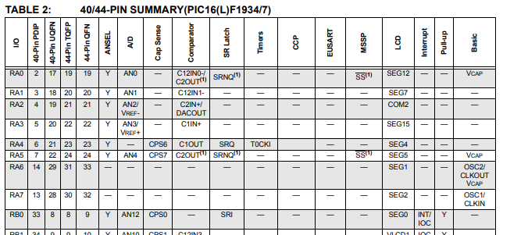
Interrupt - IOC

Slide 17
Interrupt Code
/* Interrupt-on-change enabled on the IOCx pin for a negative-going edge.
Associated Status bit and interrupt flag will be set upon detecting an edge. */
IOCBP = 0x01
IOCBN = 0x00
IOCBF = 0x00
DIR INT0 IN
INT0 = 1
// Setup the handler
On Interrupt PORTBChange Call InterruptHandler
'Loop forever
Do
LEDD3 = !LEDD3
wait 100 ms
Loop
Sub InterruptHandler
'Toggle the LED
LEDD2 = !LEDD2
' Clear interrupt flag is required to clear the interrupt
IOCBF0 = 0
End Sub

Slide 18
Lab
Walk the examples
View the scope

Slide 20
Videos...
Install the hardware and make the board work – make LEDs work
Make four LEDs flash in a sequence
Set the LEDs to represent the value of ADC
Sequence the LEDs with a delay using the value of ADC
Using an input to set the state of the LEDs
Using the reset switch
Using the switch, ADC – make the LEDs flash in a sequence with reverse
Using the serial to display values
Using the timer0 overflow, 8bit timer, 16bit timer to flash the LEDs
Using EEProm – showing values on the serial terminal, and more constants insights
Using I2C with serial to discover I2C devices
Using an I2C GCLD display
Using a SPI GCLD display
Using PWM, many ways, to dim the LEDS
Using an external interrupt to control an LED
Using storage within the chip – Progmem, EEPROM and DATA blocks
The GCBASIC tool chain
Assembly , alternatives assemblers and MPLAB-X
Summary

Slide 21
GCBASIC
PIC16Fxxxx chip Family ( Legacy )
Part 15 – External interrupt

